Slide 1
Introduction to Regression

Slide 2
Introduction
In 1800, a person named Francis Galton, was studying the relationship between parents and their children.
In particular, he investigated the relationship between height of fathers and their sons.
He discovered that a man’s son tends to be roughly as tall as his father, however, son’s height tended to be closer to the overall average height of all people.
Galton call this phenomenon as “Regression” as “father’s son height tends to regress (or drift towards) the mean (average) height of everyone else.

Slide 3
Introduction to Regression
Here is a dataset which is related to Co2 emissions from different cars.
 | ENGINESIZE | CYLINDERS | FUELCONSUMPTION_COMB | CO2EMISSION
0 | 2.0 | 4 | 8.5 | 196
1 | 2.4 | 4 | 9.6 | 221
2 | 1.5 | 4 | 5.9 | 136
3 | 3.5 | 6 | 11.1 | 255
4 | 3.5 | 6 | 10.6 | 244
5 | 3.5 | 6 | 10.0 | 230
6 | 3.5 | 6 | 10.1 | 232
7 | 3.7 | 6 | 11.1 | 255
8 | 3.7 | 6 | 11.6 | 267
9 | 2.4 | 4 | 9.2 | ?

Slide 4
Looking to the existing data of different cars, can we estimate the approx. CO2 emission of a car, which is yet not manufactured, such as in row 9 ?
We can use regression methods to predict a continuous value, such as CO2 Emission, using some other variables.
In regression there are two types of variables:
a dependent variable (which we want to predict) and
one or more independent variables (existing features).

Slide 5
The key point in the regression is that our dependent value should be continuous, and cannot be a discreet value.
However, the independent variable or variables can be either a categorical or continuous.
We use regression to build such a regression/estimation model which would be used to predict the expected Co2 emission for a new or unknown car.

Slide 6
Types of Regression Model
Simple regression is when one independent variable is used to estimate a dependent variable.
  It can be either linear on non-linear.
  Ex: predicting Co2emission using the variable of EngineSize.
When more than one independent variable is present, the process is called multiple linear regression.
  Ex: predicting Co2emission using EngineSize and the number of Cylinders in any given car.
Linearity of regression depends on the relation between dependent and independent variables; it can be either linear or non-linear regression.

Slide 7
Regression Application Areas
Essentially, we use regression when we want to estimate a continuous value.
You can try to predict a salesperson's total yearly sales (sales forecast) from independent variables such as age, education, and years of experience.
It can also be used in the field of psychology, for example, to determine individual satisfaction based on demographic and psychological factors.
We can use regression analysis to predict the price of a house in an area, based on its size, number of bedrooms, and so on.
We can even use it to predict employment income for independent variables, such as hours of work, education, occupation, sex, age, years of experience, and so on.

Slide 8
We have many regression algorithms.
Each of them has its own importance and a specific condition to which their application is best suited.

Slide 9
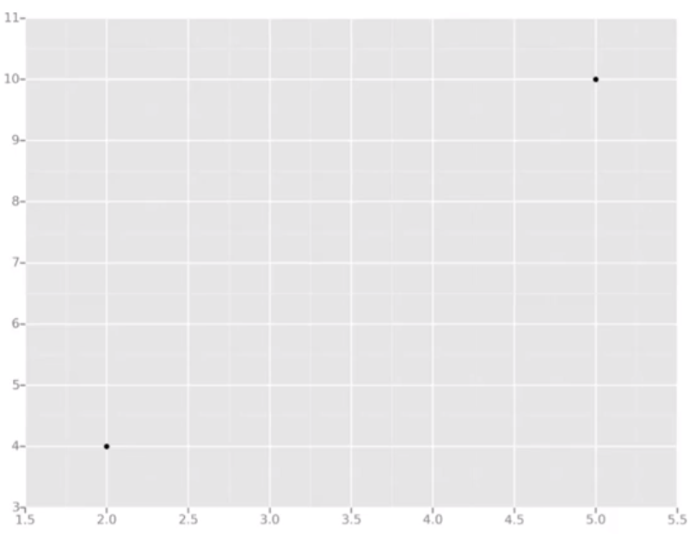
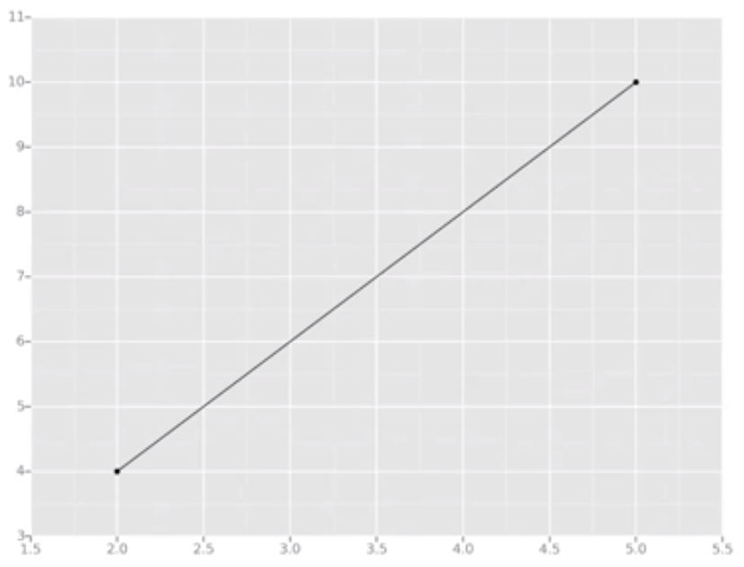
Linear Regression
How to calculate a regression with only 2 data points ?
In linear regression, we calculate regression line by drawing a line that’s as close to every dot as possible.
For classic linear regression or “Least Square Method”, you only measure the closeness in the “up and down” direction.
Here we have perfectly fitted line because we have only 2 points.

Slide 10
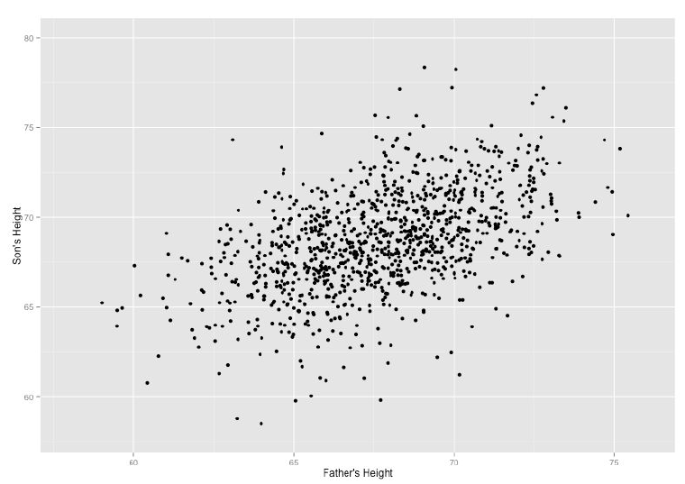
Now wouldn't it be great if we could apply this same concept to a graph with more than just two data points?
By doing this, we could take multiple men and their son’s heights and do things like tell a man how tall we expect his son to be...before he even has a son!
This is the idea behind supervised learning!

Slide 11
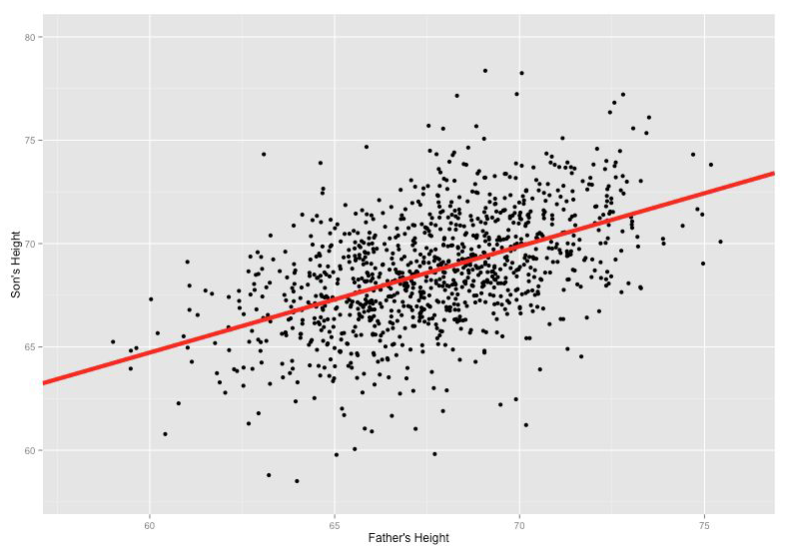
Our goal of linear regression is determining the best line by minimizing the vertical distance between all the data points and our line.
There are lots of different ways to minimize this, (sum of squared errors, sum of absolute errors, etc), but all these methods have a general goal of minimizing this distance between your line and rest of data points.

Slide 12
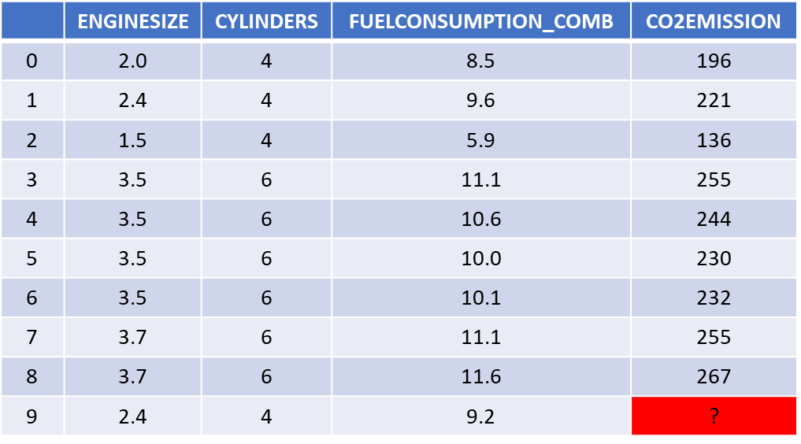
Linear Regression
This dataset is related to the Co2 emission of different cars.
The question is: Given this dataset, can we predict the Co2 emission of a car, using another field, such as Engine size?
Y: Dependent variable
X: Independent variable
Continuous values
Yes!

Slide 13
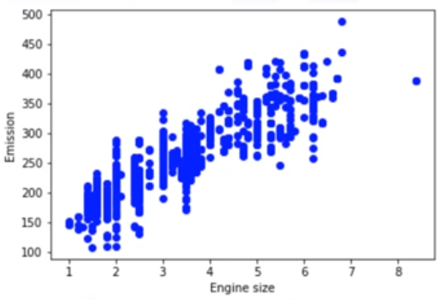
Simple Linear Regression
To understand linear regression, we can plot our variables here.
Engine size -- independent variable, Emission – dependent/target value that we would like to predict.
A scatterplot clearly shows the relation between variables where changes in one variable "explain" or possibly "cause" changes in the other variable.
Also, it indicates that these variables are linearly related.

Slide 14
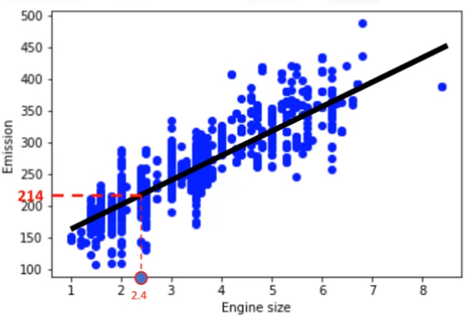
For instance, as the EngineSize increases, so do the emissions.
A good model can be used to predict what the approximate emission of each car is.
How do we use this line for prediction now?
Let us assume, for a moment, that the line is a good fit of data.
We can use it to predict the emission of an unknown car.
For example, for a sample car, with engine size 2.4, you can find the emission is 214.

Slide 15
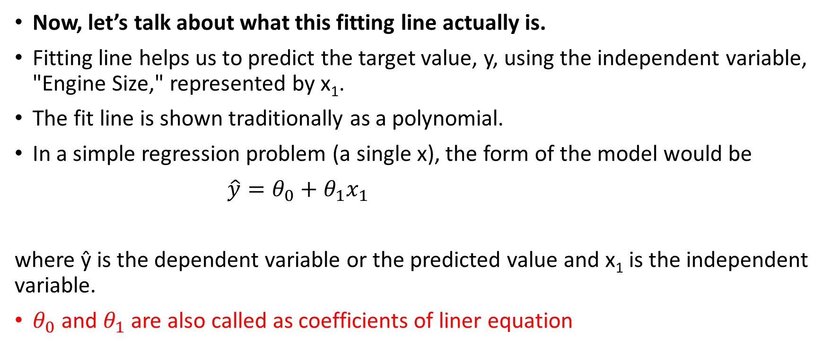
Now, let’s talk about what this fitting line actually is.
Fitting line helps us to predict the target value, y, using the independent variable, "Engine Size," represented by x₁.
The fit line is shown traditionally as a polynomial.
In a simple regression problem (a single x), the form of the model would be
$\hat{y}=θ_{0}+θ_{1}x_{1}$
where ŷ is the dependent variable or the predicted value and x₁ is the independent variable.
$θ_{0}$ and $θ_{1}$ are also called as coefficients of liner equation
intercept
Slope or gradient

Slide 16
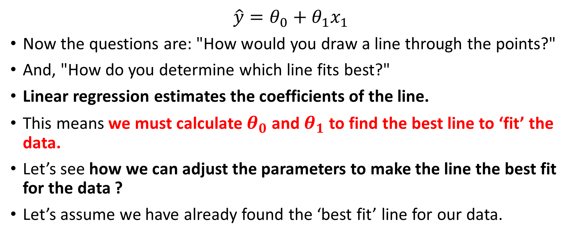
$$\hat{y}=θ_{0}+θ_{1}x_{1}$$
Now the questions are: "How would you draw a line through the points?"
And, "How do you determine which line fits best?"
Linear regression estimates the coefficients of the line.
This means we must calculate $θ_{0}$ and $θ_{1}$ to find the best line to ‘fit’ the data.
Let’s see how we can adjust the parameters to make the line the best fit for the data ?
Let’s assume we have already found the ‘best fit’ line for our data.

Slide 17
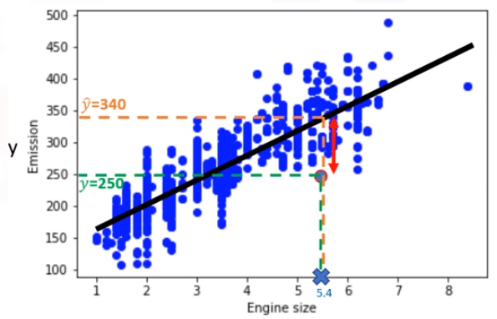
Best fit, here, means that if we have, for instance, a car with engine size x₁ =5.4, and actual Co2=250, its Co2 should be predicted very close to the actual value, which is y=250, based on historical data.
But, if we use the fit line using our polynomial with known parameters to predict the Co2 emission, it will return ŷ =340.
Now, if you compare the actual value of the emission of the car with what we predicted using our model, you will find out that we have a 90-unit error.
This means our prediction line is not accurate. This error is also called the residual error.
Error = ŷ – y = 340-250 = 90

Slide 18
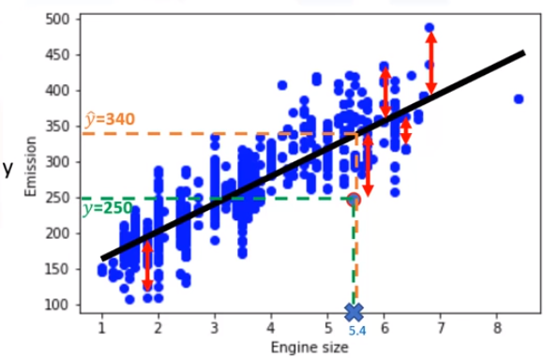
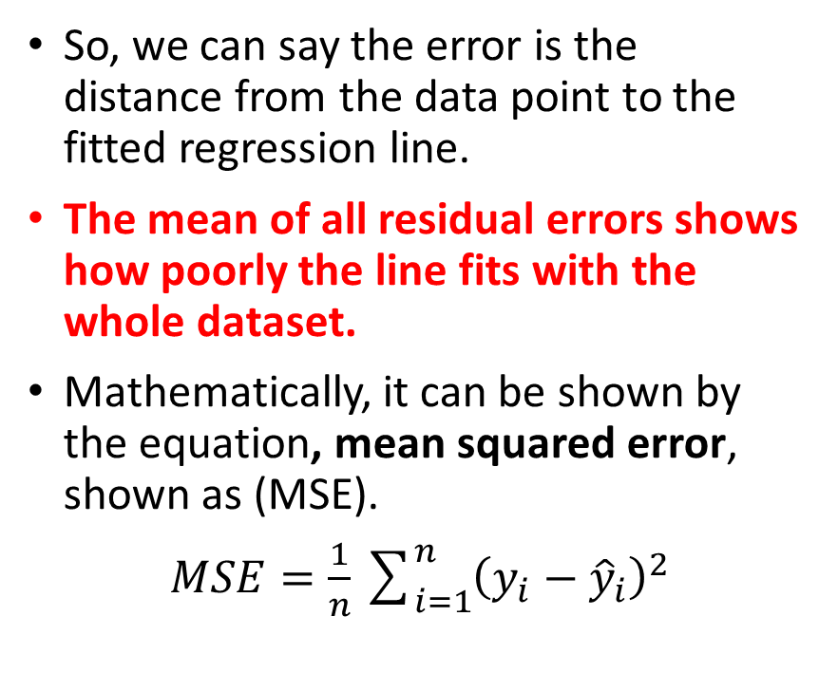
So, we can say the error is the distance from the data point to the fitted regression line.
The mean of all residual errors shows how poorly the line fits with the whole dataset.
Mathematically, it can be shown by the equation, mean squared error, shown as (MSE).
$MSE=\frac{1}{n}\sum_{i=1}^{n}{{\left(y_{i}−{\hat{y}}_{i}\right)}^{2}}$

Slide 19
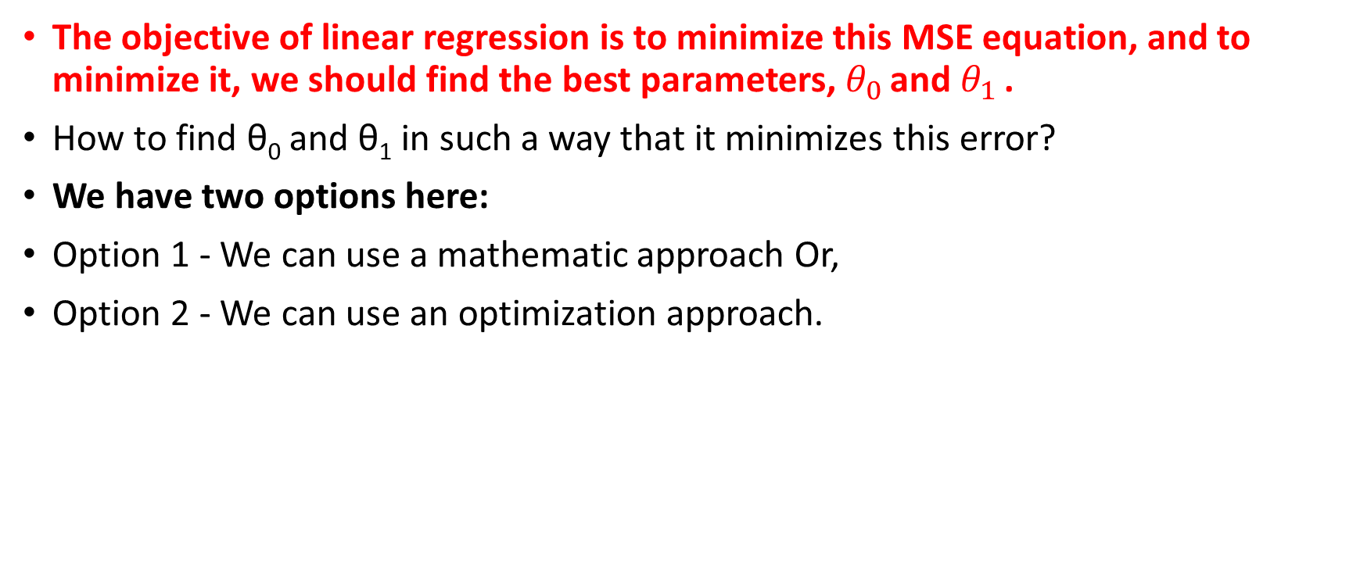
The objective of linear regression is to minimize this MSE equation, and to minimize it, we should find the best parameters, $θ_{0}$ and $θ_{1}$ .
How to find θ₀ and θ₁ in such a way that it minimizes this error?
We have two options here:
Option 1 - We can use a mathematic approach Or,
Option 2 - We can use an optimization approach.

Slide 20
Mathematical Approach
As we know, θ₀ and θ₁ (intercept and slope of the line) are the coefficients of the fit line.
It requires that we calculate the mean of the independent and dependent or target columns, from the dataset.
Notice : All of the data must be available.
It can be shown that the intercept and slope can be calculated using these equations.
We can start off by estimating the value for θ₁.

Slide 21
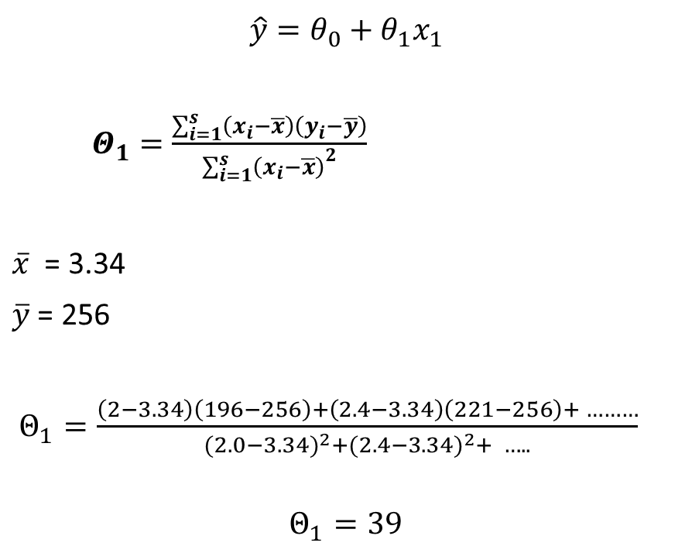
$$\hat{y}=θ_{0}+θ_{1}x_{1}$$
$Θ_{1}=$ $\frac{\sum_{i=1}^{s}{\left(x_{i}−\overline{x}\right)\left(y_{i}−\overline{y}\right)}}{{\sum_{i=1}^{s}{\left(x_{i}−\overline{x}\right)}}^{2}}$
$\overline{x}$ = 3.34
$\overline{y}$ = 256
$Θ_{1}=\frac{\left(2−3.34\right)\left(196−256\right)+\left(2.4−3.34\right)\left(221−256\right)+ ………}{{(2.0−3.34)}^{2}+{(2.4−3.34)}^{2}+ …..}$
$$Θ_{1}=39$$
$$Θ_{0}=\overline{y}−Θ_{1}\overline{x}=125.74$$

Slide 22
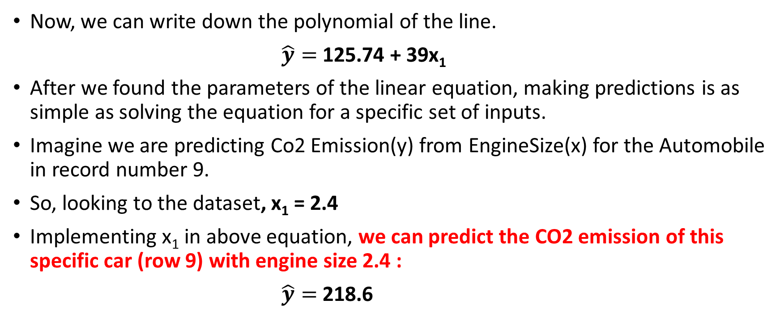
Now, we can write down the polynomial of the line.
$\hat{y}=$ 125.74 + 39x₁
After we found the parameters of the linear equation, making predictions is as simple as solving the equation for a specific set of inputs.
Imagine we are predicting Co2 Emission(y) from EngineSize(x) for the Automobile in record number 9.
So, looking to the dataset, x₁ = 2.4
Implementing x₁ in above equation, we can predict the CO2 emission of this specific car (row 9) with engine size 2.4 :
$\hat{y}=$ 218.6

Slide 23
Why Linear Regression is useful ?
It is simple to understand and use.
It is fast
No parameter tuning needed as in KNN
No Learning as in Neural Networks
Easy to understand and highly interpretable.

Slide 24
ML Hands-on Session
You have been given a dataset “FuelConsumption.csv” which contains model-specific fuel consumption ratings and estimated carbon dioxide emissions for new light-duty vehicles for retail sale in Canada
Your job is to create a model using training set and use model to predict “CO2Emission” for any new vehicle looking at its “EngineSize” using given dataset. Use Simple Linear Regression to build your model.

Slide 25
Multiple Linear Regression

Slide 26
Introduction
Considering the previous dataset, in reality, there are multiple variables that predict the Co2 emission.
When multiple independent variables are present, the process is called "multiple linear regression."
For example, predicting Co2 emission using EngineSize and the number of Cylinders in the car’s engine.
Multiple linear regression is the extension of the simple linear regression model.

Slide 27
Multiple linear regression is very useful because you can examine which variables are significant predictors of the outcome variable.
Also, you can find out how each feature impacts the outcome variable.
Y: Dependent variable
X: Independent variable
Continuous values

Slide 28
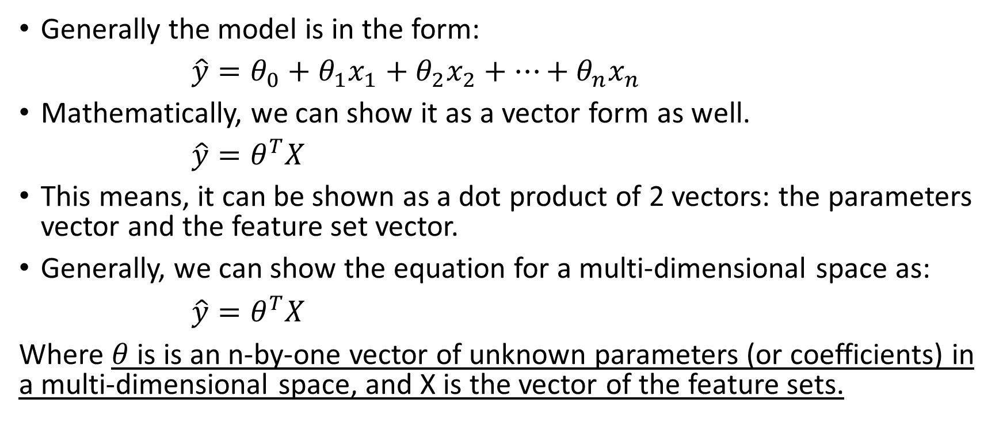
Generally the model is in the form:
$\hat{y}=θ_{0}+θ_{1}x_{1}+θ_{2}x_{2}+…+θ_{n}x_{n}$
Mathematically, we can show it as a vector form as well.
$\hat{y}=θ^{T}X$
This means, it can be shown as a dot product of 2 vectors: the parameters vector and the feature set vector.
Generally, we can show the equation for a multi-dimensional space as:
$\hat{y}=θ^{T}X$
Where $θ$ is is an n-by-one vector of unknown parameters (or coefficients) in a multi-dimensional space, and X is the vector of the feature sets.

Slide 29
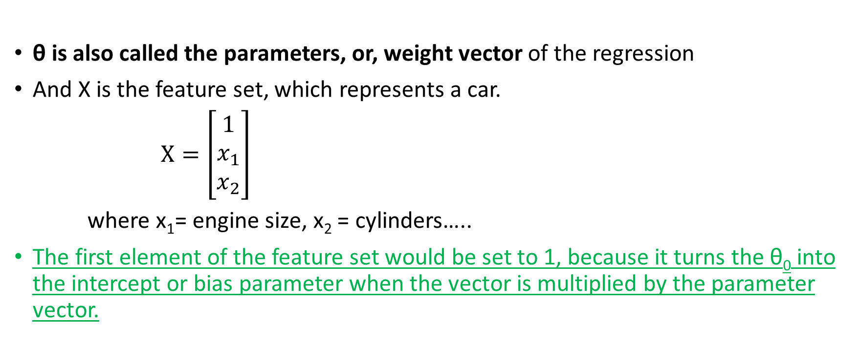
θ is also called the parameters, or, weight vector of the regression
And X is the feature set, which represents a car.
$X=\left[\begin{matrix}1 \\ x_{1} \\ x_{2}\end{matrix}\right]$
where x₁= engine size, x₂ = cylinders…..
The first element of the feature set would be set to 1, because it turns the θ₀ into the intercept or bias parameter when the vector is multiplied by the parameter vector.

Slide 30
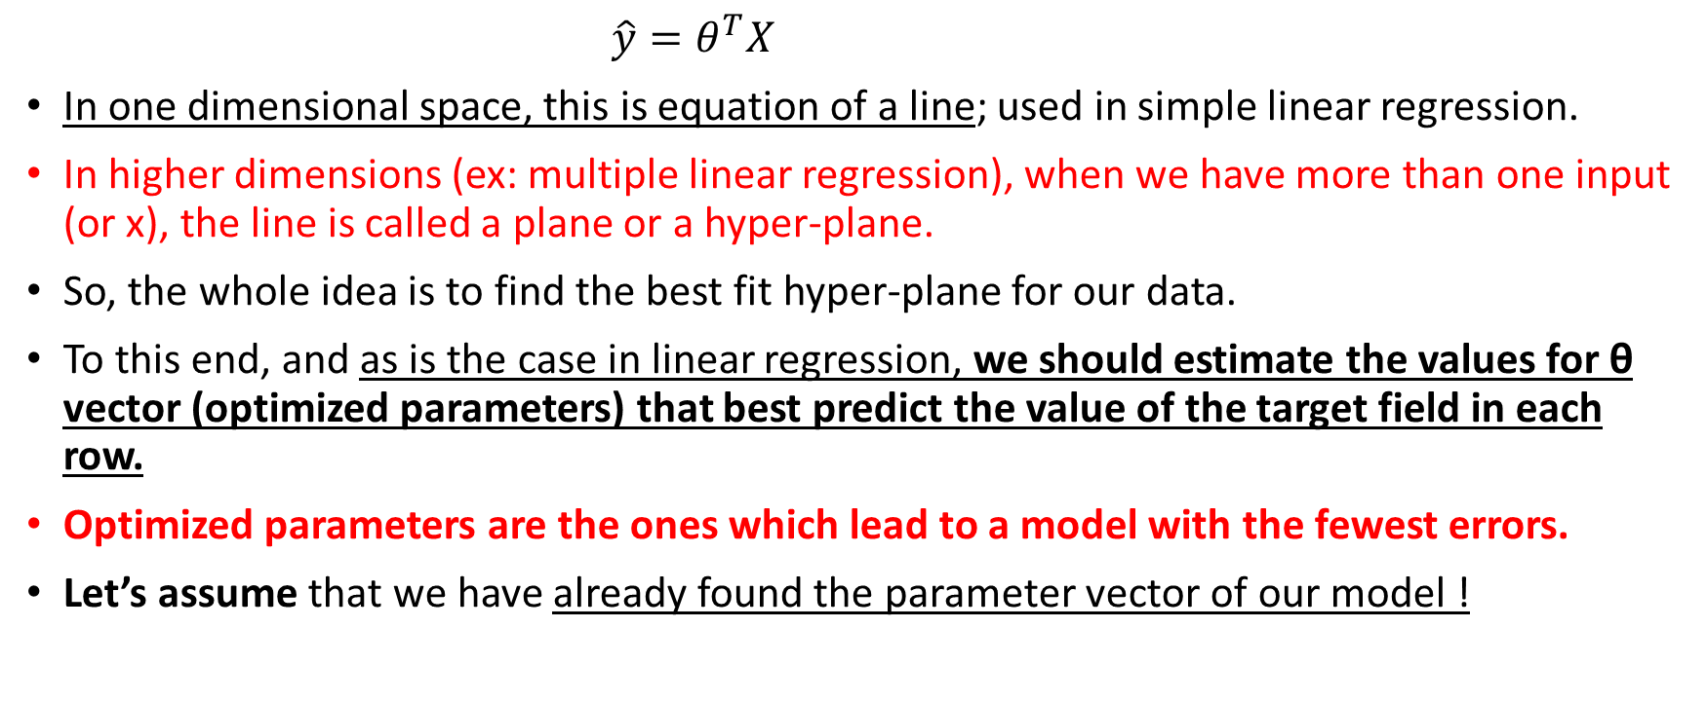
$\hat{y}=θ^{T}X$
In one dimensional space, this is equation of a line; used in simple linear regression.
In higher dimensions (ex: multiple linear regression), when we have more than one input (or x), the line is called a plane or a hyper-plane.
So, the whole idea is to find the best fit hyper-plane for our data.
To this end, and as is the case in linear regression, we should estimate the values for θ vector (optimized parameters) that best predict the value of the target field in each row.
Optimized parameters are the ones which lead to a model with the fewest errors.
Let’s assume that we have already found the parameter vector of our model !

Slide 31
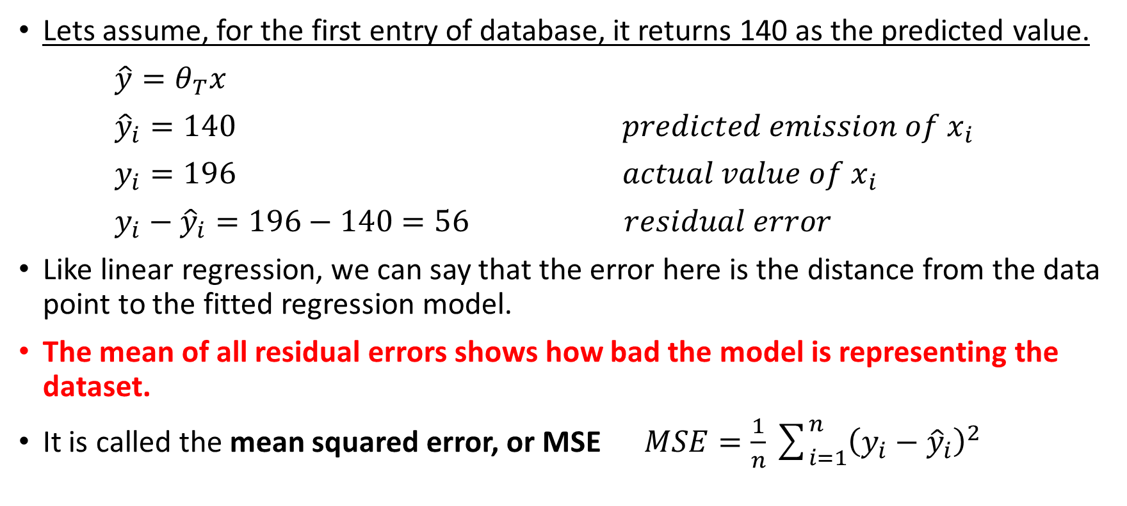
Example
Lets assume, for the first entry of database, it returns 140 as the predicted value.
$\hat{y}=θ_{T}x$
${\hat{y}}_{i}=140 predicted emission of x_{i}$
$y_{i}=196 actual value of x_{i}$
$y_{i}−{\hat{y}}_{i}=196−140=56 residual error$
Like linear regression, we can say that the error here is the distance from the data point to the fitted regression model.
The mean of all residual errors shows how bad the model is representing the dataset.
It is called the mean squared error, or MSE $MSE=\frac{1}{n}\sum_{i=1}^{n}{{\left(y_{i}−{\hat{y}}_{i}\right)}^{2}}$

Slide 32
The best model for our dataset is the one with minimum error for all prediction values.
So, the objective of multiple linear regression is to minimize the MSE equation.
To minimize it, we should find the best parameters θ.
Now, the question is, “How do we find the optimized parameters?”
However, the most common methods are the “ordinary least squares” and “optimization approach”.
This approach uses the data as a matrix and uses linear algebra operations to estimate the optimal values for the θ .

Slide 33
The problem with this technique is the time complexity of calculating matrix operations, as it can take a very long time to finish.
The second option is to use an optimization algorithm to find the best parameters.
That is, you can use a process of optimizing the values of the coefficients by iteratively minimizing the error of the model on your training data.
For example, you can use Gradient Descent, which starts optimization with random values for each coefficient.
Then, calculates the errors, and tries to minimize it through ‘wise’ changing of the coefficients in multiple iterations.

Slide 34
Gradient descent is a proper approach if you have a large dataset.
After you find the best parameters for your model, you can go to the prediction phase.
After we found the parameters of the linear equation, making predictions is as simple as solving the equation for a specific set of inputs.

Slide 35
Questions ?
How many independent variables should we use for prediction ?
Should we use all the fields in our dataset?
Does adding independent variables to a multiple linear regression model always increase the accuracy of the model?

Slide 36
Basically, adding too many independent variables without any theoretical justification may result in an over-fit model.
An over-fit model is a real problem because it is too complicated for your data set and not general enough to be used for prediction.
So, it is recommended to avoid using many variables for prediction.

Slide 37
Remember that “multiple linear regression” is a specific type of linear regression.
So, there needs to be a linear relationship between the dependent variable and each of your independent variables.
There are a number of ways to check for linear relationship.
For example, you can use scatterplots, and then visually check for linearity.
If the relationship displayed in your scatterplot is not linear, then, you need to use non-linear regression.

Slide 38
ML Hands-on Session
You have been given a dataset “FuelConsumption.csv” which contains model-specific fuel consumption ratings and estimated carbon dioxide emissions for new light-duty vehicles for retail sale in Canada
Your job is to create a model using training set and use model to predict “CO2Emission” for any new vehicle looking at its multiple feature such as “FUELCONSUMPTION_COMB”, “EngineSize” and “Cylinders” of cars, using given dataset.
Use Multiple Linear Regression to build your model.

Slide 39

Please contact
Foundation for Innovation and Collaborative
Education
mentor@fice.in
www.fice.in
Please contact
Foundation for Innovation and Collaborative
Education
info@fice.in
mentor@fice.in
Notes:
Here are the lessons we are going to learn today.

